Slide 1
NAIVE BAYES CLASSIFIER
TEAM MEMBERS
BIVASHA BASHIR BIVA
DHARMIK LOKESH SHAH
MOHAMED RAFI IBRAHIM
​
Instructor: Dr. Yasser Alginahi​
​
Date: 20th October 2023​
​
University of Windsor

Slide 2
What's in it for you
Methods to establish Classifier
What is Naïve Bayes?
Data Preprocessing
Introduction to Conditional Probability & Bayes Theorem
Zero Frequency Problem
Naïve Bayes Algorithm
Types of Naïve Bayes Classifier
Demo / Example
Advantages | Disadvantages of Naive Bayes Classifier
Application of Naïve Bayes Classifier
References

Slide 3
Methods to establish a classifier
There are three methods to establish a classifier
a) Model a classification rule directly
Examples: k-NN, decision trees, perceptron, SVM
b) Model the probability of class memberships given input data
Example: multi-layered perceptron with the cross-entropy cost
c) Make a probabilistic model of data within each class
Examples: Naive Bayes, model-based classifiers
a) and b) are examples of discriminative classification
c) is an example of generative classification
b) and c) are both examples of probabilistic classification

Slide 4

INTRODUCTION TO NAÏVE BAYES CLASSIFIER
Machine Learning
Naïve bayes classifier assumes that all the features are unrelated to each other. Presence or absence of a feature does not influence the presence or absence of any other feature.
It is a Statistical method for classification.
It Can solve problems involving both categorical and continuous-valued attributes.
Comes under Supervised Learning.
Assumes an underlying probabilistic model, the Bayes theorem.
Supervised Learning
Unsupervised Learning
Classification
Regression
Naïve Bayes

Slide 5

Introducing Naïve Bayes Classifier
Principles of conditional probability given by Bayes' theorem
Let's understand the simple concepts in probability that are used in this algorithm

Slide 6
DATA PREPROCESSING
If a dataset is non-continuous (categorical or discrete) data, we will need to preprocess it before applying Gaussian Naive Bayes.
Here's how you can handle non-continuous data:
Convert Categorical Data: For categorical or discrete features, you will need to convert them into a continuous representation. This can be done using techniques like one-hot encoding or label encoding.
Handle Missing Values: This can involve imputation with mean, median, or mode for continuous features and using a specific category for missing values in categorical features.

Slide 7
CONDITIONAL PROBABILITY
In probability theory, conditional probability is a measure of the probability of an event given that another event has already occurred.
If the event of interest is A and the event B is assumed to have occurred, "the conditional probability of A given B", or "the probability of A under the condition B", is usually written as P(A|B), or sometimes PB(A).

Slide 8
Example 1: Chances of cough
The probability that any given person has a cough on any given day maybe only 5%. But if we know or assume that the person has a cold, then they are much more likely to be coughing. The conditional probability of coughing given that person have a cold might be a much higher 75%.

Slide 9
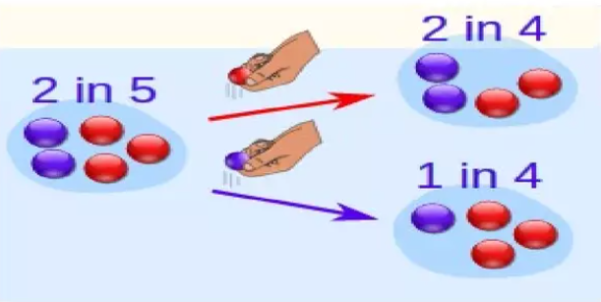
Example 2: Probability of getting a blue marble
2 blue and 3 red marbles are in a bag. What are the chances of getting a blue marble?
Answer : - The chance is 2/5
But after taking one out of these chances, situation , may change!
So, the next time:
If we got a red marble before, then the chance of a blue marble next is 2/4
If we got a blue marble before, then the chance of a blue marble next is 1/4
Figure: Probability of getting a blue marble [3]

Slide 10
Zero Frequency Problem!
What if any of the count is 0?
Add 1 to all counts
It is a form of Laplace Smoothing
See https://en.wikipedia.org/wiki/Additive_smoothing
Formula: The probability of a feature given a class after Laplace Smoothing is calculated as follows:
P(feature | class) = (Count(feature in class) + 1) / (Total count of features in class + Number of unique features)

Slide 11
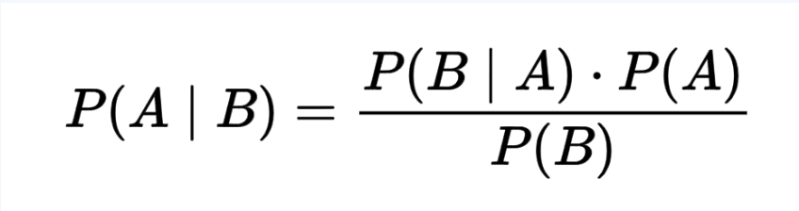
Introducing Bayes Theorem
Bayes' theorem gives the conditional probability of an event A given another event B occurred
Bayes Theorem
Where,
P(A|B) = conditional probability A given B (posterior probability)
P(B|A) = conditional probability of B given A (likelihood)
P(A) = probability of event A (class prior probability)
P(B) = probability of event B (predictor prior probability)
The conditional probability of occurrence of an event based on prior knowledge of conditions that might be related to the event

Slide 12
Types of Naïve Bayes Classifier
Multinomial Naïve Bayes
Gaussian Naïve Bayes
Bernoulli Naïve Bayes

Slide 13

Multinomial Bayesian model:
A probabilistic classification model.
Used in text classification.
Assigns documents to predefined categories.
Calculates class probability based on word/feature frequency and Bayes' theorem.
For instance, when classifying movie reviews as "positive" or "negative," feature frequencies involve word counts like "good," "bad," "amazing," and "terrible." The Bayesian model uses these frequencies to determine whether the review falls into the "positive" or "negative" category.

Slide 14
Example for Multinomial Naïve Bayes:
Frequency table of the training data set given count of all the Cricket Playing conditions against the respective weather condition
Find the probabilities of each weather condition and create a likelihood table
WEATHER | YES | NO
SUNNY | 3 | 2
OVERCAST | 4 | 0
RAINY | 2 | 3
TOTAL | 9 | 5
WEATHER | YES | NO
SUNNY | 3 | 2 | 5/14(0.36)
OVERCAST | 4 | 0 | 4/14(0.29)
RAINY | 2 | 3 | 5/14(0.36)
TOTAL | 9 | 5
P(Yes) = 9/14(0.64)
P(No) = 5/14(0.36)

Slide 15
After replacing variables in the above formula, we get:
P(Yes | Sunny) = P(Yes) * P(Sunny | Yes) / P(Sunny)
Take the values from the above likelihood table and put it in the above formula.
P(Sunny | Yes) = 3/9 = 0.33, P(Yes) = 0.64 and P(Sunny) = 0.36
Hence, P(Yes | Sunny) = (0.64*0.33)/0.36 = 0.60
P(No | Sunny) = P(No) * P(Sunny | No) / P(Sunny)
Take the values from the above likelihood table and put it in the above formula.
P(Sunny | No) = 2/5 = 0.40, P(No) = 0.36 and P(Sunny) = 0.36
P(No | Sunny) = (0.36*0.40)/0.36 = 0.6 = 0.40
The probability of playing cricket in sunny weather conditions is higher. Hence, the player will play if the weather is sunny.

Slide 16

Gaussian Naïve Bayes
Assumes that continuous features in dataset follow a Gaussian(Normal) distribution
Variance (σ²) and Mu (μ) of the continuous variable X computed for a given class c of Y.

Slide 17
Example for Gaussian Naïve Bayes:-
Let's consider a simple example of a Gaussian Naive Bayes classifier using mathematical terms and calculations:
Suppose we have a dataset with two features, X1​ and X2​, and a binary target variable Y indicating two classes (0 or 1). We want to predict the class label based on these features.
Let's say we have the following data points:
Data points: X1:[1.2,0.8,1.0,1.5,1.3]
X2:[1.0,1.5,1.2,0.9,1.3]
Y:[1,0,1,0,1]
To use Gaussian Naive Bayes, we need to calculate the mean (μ) and standard deviation (σ) for each feature in each class. Let's compute these values for both classes (0 and 1).

Slide 18
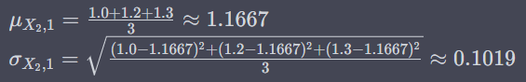
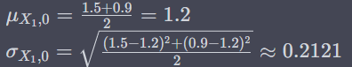
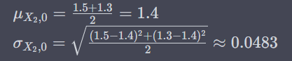
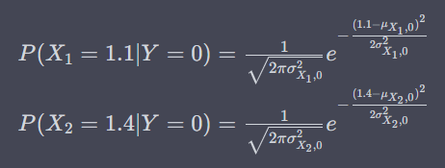
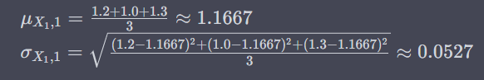
For Class 0 (Y=0):
Mean and Standard Deviation for X1:
Mean and Standard Deviation for X2:
For Class 1 (Y=1):
Mean and Standard Deviation for X1​:
Mean and Standard Deviation for X2:
Now, given a new data point (x1​,x2​)=(1.1,1.4), we can calculate the likelihoods for both classes using the Gaussian probability density function:
For Class 0 (Y=0):

Slide 19
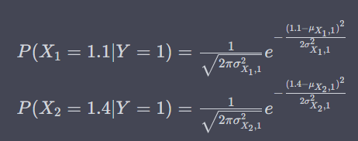
For Class 1 (Y=1):
Finally, we can calculate the posterior probabilities using Bayes' theorem and predict the class with the higher probability as the output class for the given data point.

Slide 20
Bernoulli Naïve Bayes
Efficient for binary feature tasks like text classification.
Thrives with limited resources and small datasets.
Performance may suffer if feature independence is violated or feature frequency matters.
For instance, while classifying emails into two classes: "spam" and "not spam." You've trained your model on a dataset of emails, and one of the features you're using is the presence or absence of the word "offer." The Bayesian model uses this features to determine whether the Email is a "Spam" or "Ham".

Slide 21
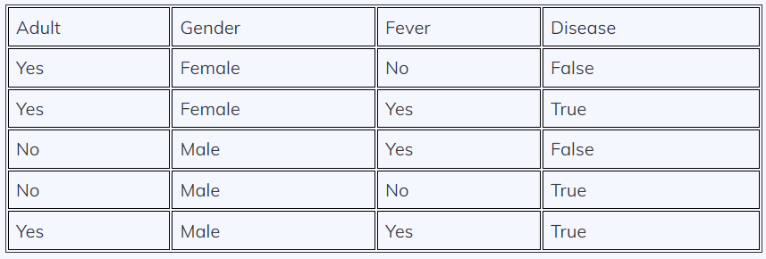
Example for Bernoulli Naïve Bayes :-
In the Below dataset, we are trying to predict whether a person has a disease or not based on their age, gender, and fever. Here, ‘Disease’ is the target, and the rest are the features.
Figure: Diagnosis of fever and Disease [5]
Firstly, we calculate the class probability, probability of disease or not.
P(Disease = True) = ⅗
P(Disease = False) = ⅖
Secondly, we calculate the individual probabilities for each feature.
P(Adult= Yes | Disease = True) = ⅔
P(Gender= Male | Disease = True) = ⅔
P(Fever= Yes | Disease = True) = ⅔
P(Adult= Yes | Disease = False) = ½
P(Gender= Male | Disease = False) = ½
P(Fever = Yes | Disease = False) = ½
All values are binary. We wish to classify an instance ‘X’ where Adult=’Yes’, Gender= ‘Male’, and Fever=’Yes’.

Slide 22
Now, we need to find out two probabilities:-
(i) P(Disease= True | X) = (P(X | Disease= True) * P(Disease=True))/ P(X)
(ii) P( Disease = False | X) = (P(X | Disease = False) * P(Disease= False) )/P(X)
P(Disease = True | X) = (( ⅔ *⅔ * ⅔ ) * (⅗))/P(X) = (8/27 * ⅗) / P(X) = 0.17/P(X)
P(Disease = False | X) = [(½ * ½ * ½ ) * (⅖)] / P(X) = [⅛ * ⅖] / P(X) = 0.05/ P(X)
Now, we calculate estimator probability:-
P(X) = P(Adult= Yes) * P(Gender = Male ) * P(Fever = Yes)
= ⅗ * ⅗ * ⅗ = 27/125 = 0.21
So we get finally,
P(Disease = True | X) = 0.17 / P(X)
= 0.17 / 0.21
= 0.80 -------- (eq-1)
P(Disease = False | X) = 0.05 / P(X)
= 0.05 / 0.21
= 0.23 -------- (eq-2)
Now, we notice that (1) > (2), the result of instance ‘X’ is ‘True’, i.e., the person has the disease.

Slide 23
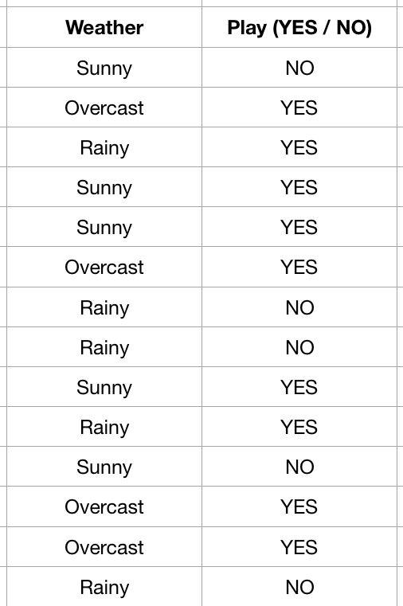
How Naïve Bayes algorithm works (Example)
We are training dataset of weather and corresponding target variable 'Play'.
Now, we need to classify whether players will play the cricket match or not based on weather condition.
Figure: play condition based on weather. [6]

Slide 24
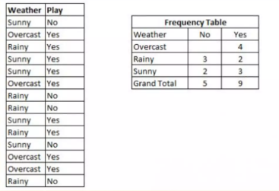
Convert the dataset into a frequency table.
Figure: play condition based on weather. (6)

Slide 25
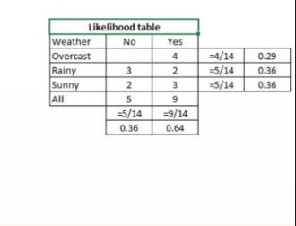
Create likelihood table by finding the probabilities like Overcast probability = 0.29 and probability of playing is 0.64.
Now, use the Naïve Bayesian equation to calculate the posterior probability for each class. The class with the highest posterior probability is the outcome of prediction.
Figure: play condition based on weather.[6]

Slide 26
Problem: Players will play if weather is sunny. Is this statement correct?
P(Yes | Sunny) = P(Sunny | Yes)*P(Yes)/P(Sunny)
Here we have,
P(Sunny | Yes) = 3/9 = 0.33, P(Sunny) = 5/14 = 0.36,
P(Yes) = 9/14 = 0.64
Now, P(Yes | Sunny) = 0.33 * 0.64 / 0.36 = 0.60, (high probability)

Slide 27
Problem: Players will play if weather is sunny. Is this statement correct?
P(No | Sunny) = P(Sunny | No)*P(No)/P(Sunny)
Here we have,
P(Sunny | No) = 2/5 = 0.4, P(Sunny) = 5/14 = 0.36,
P(No) = 5/14 = 0.36
Now, P(No | Sunny) = 0.4 * 0.36 / 0.36 = 0.40, (low probability)

Slide 28
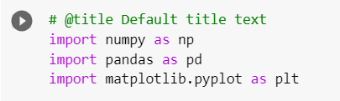
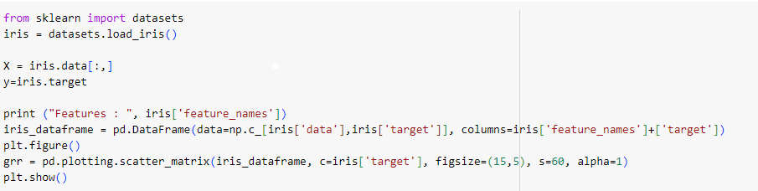
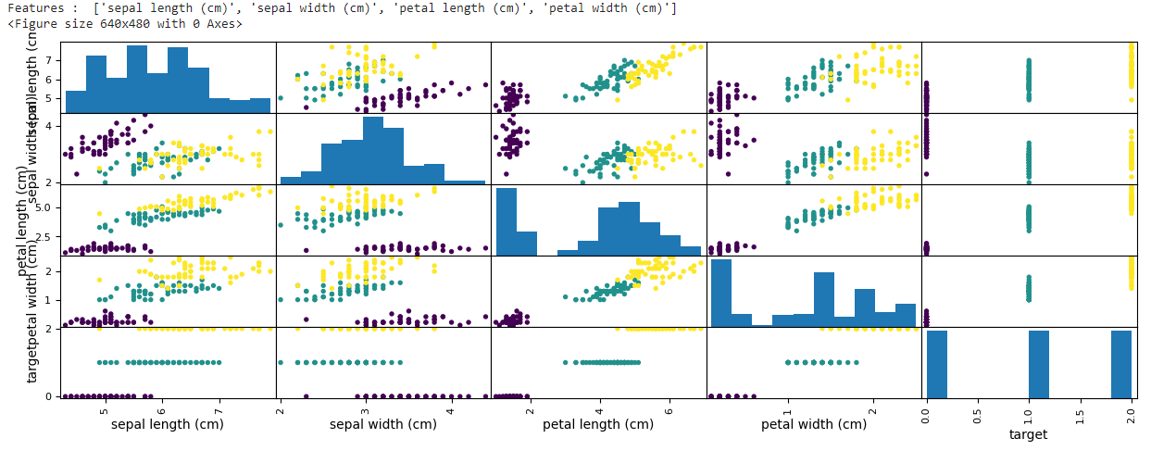
DEMO | A sample code describing Gaussian NB
Standard Libraries like numpy, pandas and matplotlib are used to perform numeric operations, managing data and visualizing the analysis of data
Loading the Dataset and Visualizing the scatter-plot features

Slide 29
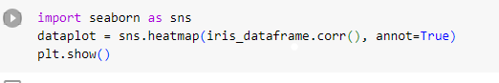
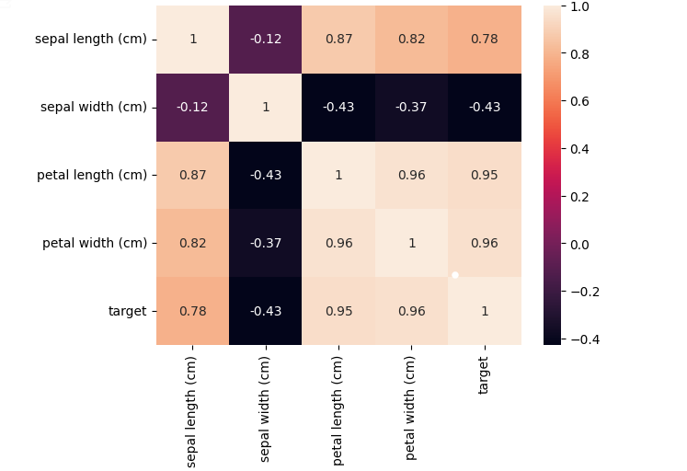
A sample code describing Gaussian NB
Visualizing the correlation and checking the assumption of Naïve Bayes
From this we can see the features are highly correlated. But as per Naïve Bayes assumption, it will treat features as independent of each other. Based on this, our algorithm will compute the following probability of all 3 flower classes

Slide 30
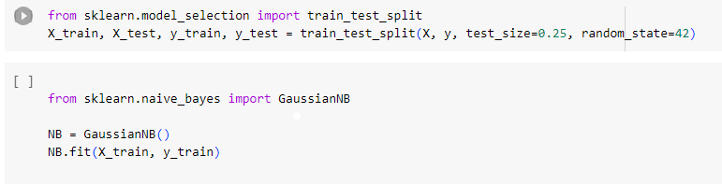
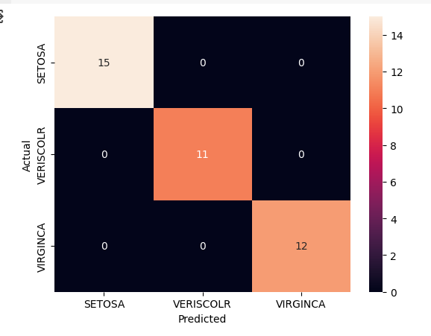
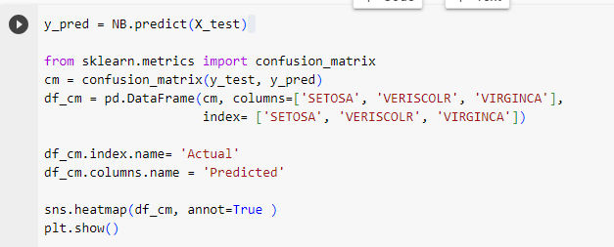
A sample code describing Gaussian NB
Train the model
Evaluate the model
Predict the Model Output

Slide 31
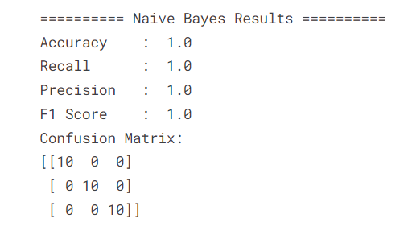
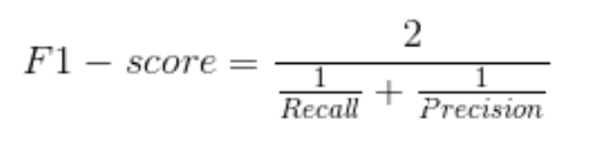
A sample code describing Gaussian NB
The confusion Matrix allows us to measure Recall and Precision, which, along with Accuracy and the AUC-ROC curve, are the metrics used to measure the performance of ML models.
Precision (positive predicted) is the fraction of relevant data among the retrieved data. On the other hand, recall (sensitivity) is the fraction of relevant data that were retrieved. Both precision and recall are based on relevance.
F1 score is more useful than accuracy, especially when you have an uneven class distribution. The F1-score captures both the trends in a single value:

Slide 32
YOUTUBE VIDEO
For understanding Gaussian Naïve Bayes Algorithm
https://youtu.be/l3dZ6ZNFjo0?si=e5mxd0EJv7XT_Om6
To understand Bayesian theorem and how its used in Naïve Bayes
https://youtu.be/lFJbZ6LVxN8?si=RTp07Dp1G4_g-wOc
A detailed code description from scratch to build Naïve Bayes Classifier https://tinyurl.com/45wk35u8

Slide 33
ADVANTAGES
Very simple and easy to implement
Needs less training data
Handles both continuous and discrete data
Highly scalable with number of predictors and data science
Not sensitive to irrelevant features
DISADVANTAGES
They are quick and easy to implement but their biggest disadvantage is the requirement for predictors needs to be independent.

Slide 34
APPLICATIONS
Naive Bayes can work surprisingly well in many practical applications, especially when you have limited data or want a simple and interpretable model.
Document Categorization: Naive Bayes is used for categorizing documents into predefined categories or topics, such as news articles, research papers, or user reviews.
Medical diagnosis: In medical applications, Naive Bayes can help in diagnosing diseases based on a set of symptoms or test results.
Credit Scoring: In the finance industry, Naive Bayes can be used to assess the creditworthiness of individuals based on their financial history and other factors

Slide 35
REFERENCES
[1] Wikimedia Foundation. (2023, October 16). Bayes’ theorem. Wikipedia. https://en.wikipedia.org/wiki/Bayes%27_theorem
[2] Comparison between multinomial and Bernoulli naïve Bayes for text ..., https://ieeexplore.ieee.org/document/8776800 (accessed Oct. 27, 2023).
[3] Banoula, M. (2023, August 29). Naive Bayes classifier: Simplilearn. Simplilearn.com. https://www.simplilearn.com/tutorials/machine-learning-tutorial/naive-bayes-classifier
[4]Coding ninjas studio. Available at: https://tinyurl.com/2s4x43pf
[5] https://www.upgrad.com/blog/gaussian-naive-bayes/
[6] Gaussian Naïve Bayes: https://www.ibm.com/topics/naive-bayes

Slide 36
REFERENCES
IMAGES
[1] https://tinyurl.com/5fsvthvr
[2] https://tinyurl.com/yckfb38n
[3] https://www.enjoyalgorithms.com/blog/naive-bayes-in-ml
[4] Naive Bayes classifier PPT. Available at: https://www.slideshare.net/knoldus/naive-bayes-classifier-99907521 (Accessed: 18 October 2023).
[5] Coding ninjas studio. Available at: https://www.codingninjas.com/studio/library/bernoulli-naive-bayes (Accessed: 25 October 2023).
[6] Naive Bayes PPT. Available at: https://www.slideshare.net/CloudxLab/naive-bayes-99709376 (Accessed: 18 October 2023).

